Slide 1
Utilizing Artificial Neural Networks for Forecasting Stock Market Trends (ANN)
PRESENTED BY:RAM PRASATH S
REGISTER NO:211521104124
DEPARTMENT:COMPUTER SCIENCE AND ENGINEERING

Slide 2
PROJECT TITLE
Utilizing Artificial Neural Networks for Forecasting Stock Market Trends

Slide 3


AGENDA
Problem Statement
Project Overview
End Users
Our Solution and Proposition
Key Features
Modelling Approach
Results and Evaluation
Conclusion
3/21/2024 Annual Review

Slide 4

PROBLEM STATEMENT
To develop a reliable and accurate model using Artificial Neural Networks (ANN) to forecast stock market trends. This entails leveraging historical market data and training the ANN to identify patterns and correlations, ultimately enabling informed decision-making for investors and financial analysts. Through this project, we aim to enhance prediction accuracy, reduce investment risks, and optimize portfolio management strategies in dynamic market environments.

Slide 5

PROJECT OVERVIEW
This project aims to leverage the power of Artificial Neural Networks (ANNs) to predict and forecast stock market trends accurately. By harnessing advanced machine learning techniques, we seek to develop a robust model capable of analyzing historical market data and identifying patterns that can indicate future market movements. Through the integration of ANNs, renowned for their ability to recognize complex patterns in data, we endeavor to enhance predictive accuracy and optimize investment strategies. This project not only addresses the challenge of stock market prediction but also showcases the potential of artificial intelligence in financial forecasting.

Slide 6

WHO ARE THE END USERS?
Investors and Traders:
Individual investors and professional traders seeking to make informed decisions on buying, selling, or holding stocks.
Financial Analysts:
Professionals responsible for analyzing market trends, valuing securities, and providing investment recommendations to clients or organizations.
Algorithmic Trading Firms:
Companies specializing in automated trading strategies, utilizing predictive models to execute trades at optimal times and prices.
Risk Management Professionals:
Risk analysts and managers tasked with assessing and mitigating potential financial risks associated with market volatility and investment decisions.
Academic Researchers:
Scholars and students in the fields of finance, economics, and artificial intelligence conducting research on stock market prediction methodologies and their applications.
Financial Technology (FinTech) Companies:
Developers and providers of financial software and platforms integrating predictive analytics capabilities for their clients.
\Retail Banking and Wealth Management:
Retail banks and wealth management firms offering investment advisory services to their customers, utilizing predictive models for personalized financial planning.

Slide 7

OUR SOLUTION AND ITS VALUE PROPOSITION
Our Solution:
We leverage Artificial Neural Networks (ANNs) to analyze historical stock market data and predict future trends with precision. By harnessing the power of deep learning algorithms, our system identifies complex patterns and correlations within the data to make accurate predictions.
Value Proposition:
Enhanced Accuracy: Our solution provides highly accurate forecasts, enabling investors to make informed decisions and capitalize on market opportunities.
Efficient Decision-Making: By automating the analysis process, we streamline decision-making, saving time and resources for traders.

Slide 8

THE "WOW" IN OUR SOLUTION
Our Groundbreaking Solution:
Harnessing the power of Artificial Neural Networks (ANN) to accurately forecast stock market trends. Our innovative approach employs cutting-edge machine learning techniques to analyze vast amounts of data, enabling precise predictions with unprecedented accuracy. By leveraging ANN's ability to detect intricate patterns and relationships within complex financial datasets, we empower investors with actionable insights, allowing them to make informed decisions and stay ahead of the curve in today's dynamic markets. Experience the future of stock market forecasting with our revolutionary solution.
3/21/2024 Annual Review
8

Slide 9
MODELLING
Artificial Neural Network (ANN):
Definition and Structure:
Introduction to Artificial Neural Networks (ANNs) as computational models inspired by the biological neural networks in the human brain.
Functionality and Learning:
Overview of how ANNs process information through a series of mathematical operations, including activation functions and weight adjustments.
Training Process:
1.Forward Propagation:
Explanation of forward propagation, the process by which input data is passed through the neural network to generate predictions.
2.Backpropagation:
Overview of backpropagation, the method used to update the weights of the neural network based on the calculated error.
Data Preprocessing
Data Cleaning and Transformation:
Explanation of data cleaning techniques to handle missing values, outliers, and inconsistencies in the dataset.
9

Slide 10
Fine-tuning and Regularization:
Fine-tuning Hyperparameters:
Explanation of hyperparameters in neural networks, including learning rate, batch size, and number of hidden layers.
Regularization Techniques:
Overview of regularization methods such as L1 and L2 regularization to prevent overfitting by penalizing large weights.
Model Evaluation:
1.Performance Metrics:
Introduction to common evaluation metrics for regression tasks such as Mean Absolute Error (MAE), Mean Squared Error (MSE), and Root Mean Squared Error (RMSE).
2.Cross-Validation:
Explanation of cross-validation techniques such as k-fold cross-validation to assess the generalization performance of the model.

Slide 11
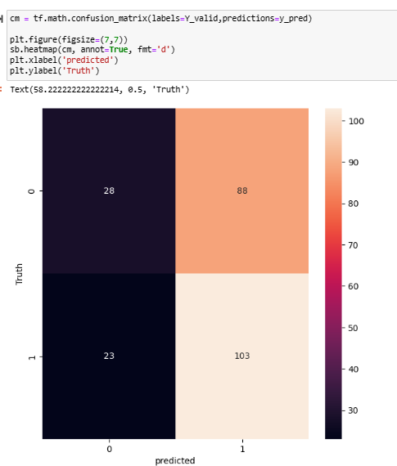
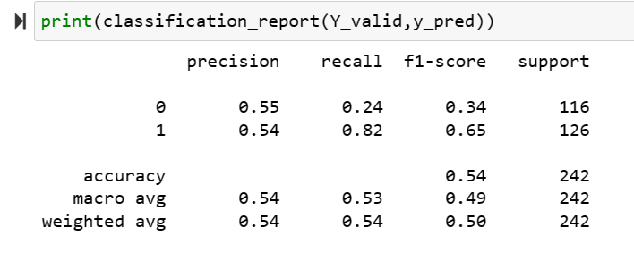
RESULTS
11

Slide 12
Evaluation:
Strengths:
Innovative Approach: Leveraging artificial neural networks showcases a cutting-edge methodology for stock market forecasting.
Advanced Technology: Utilizing artificial neural networks demonstrates a commitment to employing sophisticated technologies in financial analysis.
Improved Accuracy: Neural networks have the potential to enhance prediction accuracy by recognizing complex patterns in market data.
Weaknesses:
Data Dependency: The accuracy and reliability of predictions heavily depend on the quality and quantity of historical market data.
Complexity: Implementing neural networks requires expertise in machine learning and may involve complex algorithms, posing challenges for some stakeholders.
Resource Intensive: Training and maintaining neural network models may require significant computational resources and time investment.

Slide 13
conclusion
Utilizing artificial neural networks for forecasting stock market trends offers a promising avenue for enhancing predictive capabilities in financial markets. While there are challenges to overcome, the potential benefits in terms of accuracy and informed decision-making make this approach worthy of further exploration and investment.

